Slide 1
Calculator
Software Studio 軟體設計與實驗
Hung-Kuo Chu
Department of Computer Science
National Tsing Hua University
CS2410

Slide 2
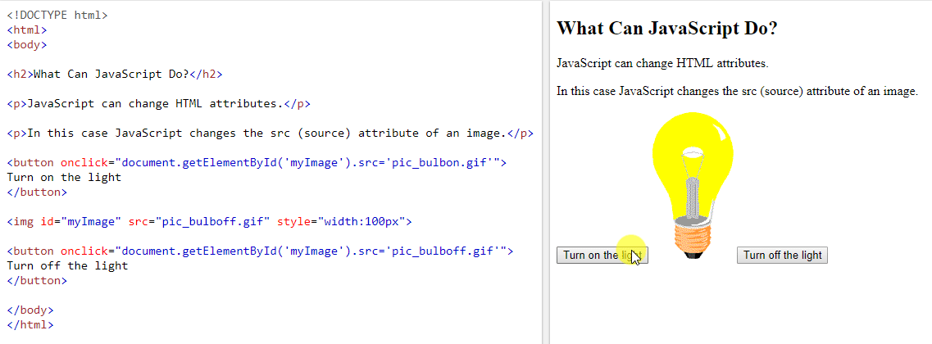
HTML with JavaScript
Now you have learned the basic scripting of JavaScript, then you can use JS to make your HTML pages more dynamic and interactive!

Slide 3
onclick Event
The onclick event occurs when the user clicks on an element.
The click event will occur after the mousedown and mouseup events.
Only one onclick handler can be assigned to an object at a time with this property.
MDN onclick
w3schools onclick
<element onclick="myScript">

Slide 4
Keyboard Event
onkeydown, onkeypress or onkeyup
Keyboard event can be an object that describe a user interaction with the keyboard.
MDN Keyboard
w3schools Keyboard
<body onkeypress=“myscript”></body>

Slide 5
DOM
The Document Object Model (DOM) is an application programming interface for HTML.
It defines the logical structure of documents and the way a document is accessed and manipulated.

Slide 6
Document
The HTML DOM document object is the owner of all other objects in your web page.
Document object represents your web page.
If you want to access any element in your web page, always start with accessing the document object.

Slide 7
Finding HTML Elements
The getElementById() method returns the element that has the ID attribute with the specified value.
An ID should be unique within a page.
If more than one, return the first element.
var text = document.getElementById("screen”);
text.value = “Hello world!”

Slide 8
Change HTML elements
We can modify the content of an HTML element by using innerHTML.
Change the value of an attribute.
document.getElementById(id).innerHTML = new HTML;
document.getElementById(id).src = ”example.jpg";

Slide 9
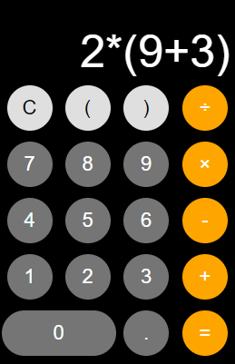
Web calculator

Slide 10
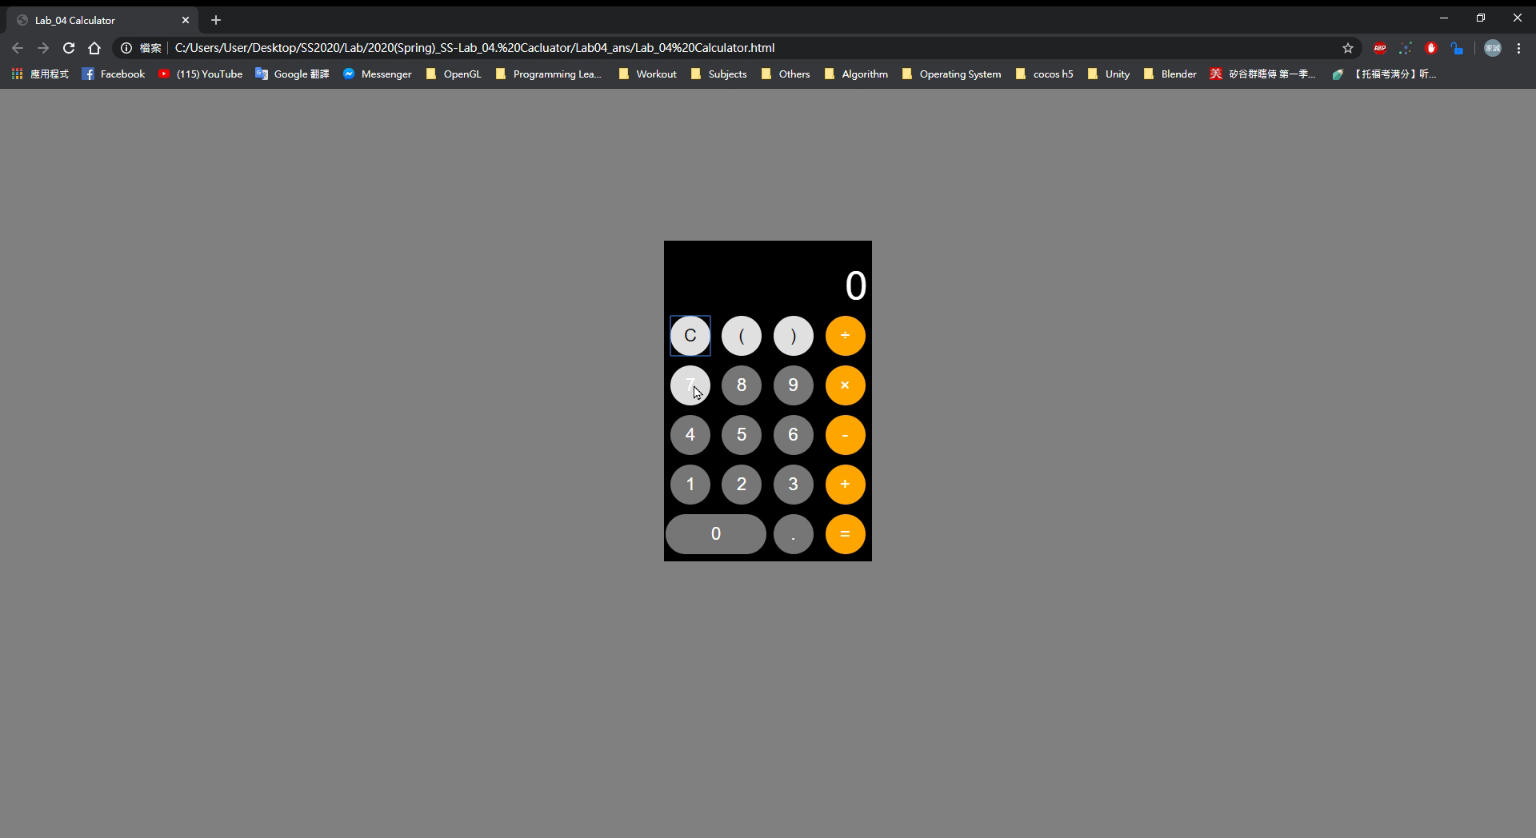
Goal example

Slide 11
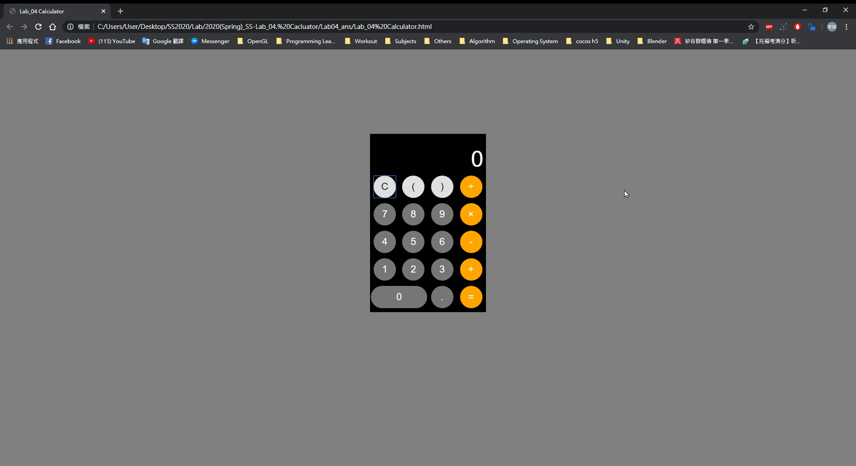
Keyboard and backspace
1 2 3 + 4 5 6 Backspace Backspace

Slide 12
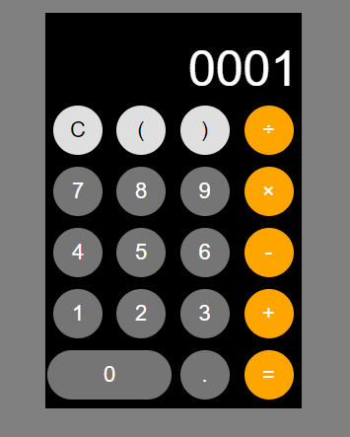
This is not acceptable
Ex. 001+001, 1+01, 00+000…

Slide 13
Goal
Fork the repo to your local repository.
Complete the web calculator.
Display input sequence on calculator’s screen, and when a “=” is clicked or Enter is pressed, show the evaluate result.
If the input sequence is an illegal argument, show the error message. (ex. 3+/5)
Deadline: 2022/03/25 17:20

Slide 14
Hints
Trace the HTML code first! All you have to do is within html and javascript code.
Use onclick and onkeydown event handler to pass value to JavaScript.
When passing the input value ‘×’ and ‘÷’, you can directly pass ‘*’ and ‘/’ into the function.
Use getElementbyID to get input text element.
Make use of eval() function.
The try and catch statements can help you easily handle illegal argument.
What does eval() function return, when it is illegal?

Slide 15
Grading Policy
Item | Score
Correct evaluated result(include floating point) | 40%
Show “error” on the screen when input is illegal | 20%
Mouse click the input button work properly | 15%
Keyboard type in work properly. 1. Only numeric keypad is necessary, including 1~9, /, *, -, +, Enter 2. Enter will show the evaluate result | 10%
Implement backspace by keyboard | 10%
Solve the multiple 0 problem (this may take time!) | 5%

